Slide 1



SMARTPHONE PROCESSORS
The National Institute of Engineering
Department of Electrical and Electronics Engineering
Mananthavadi Road, Mysore-570008
UNDER THE GUIDANCE OF,
MS. ASHWINI G,
Assistant Professor
BY
RAVI N 4NI19EE082

Slide 2
CONTENTS
WHAT DETERMINES THE PROCESSOR SPEED?
CLOCK SPEED
NANOMETER TECHNOLOGY
SMARTPHONE PROCESSORS RANKING
APPLE BIONIC CHIPS
QUALCOMM SNAPDRAGON
MEDIATEK
EXYNOS
REFERENCES
CONCLUSION

Slide 3
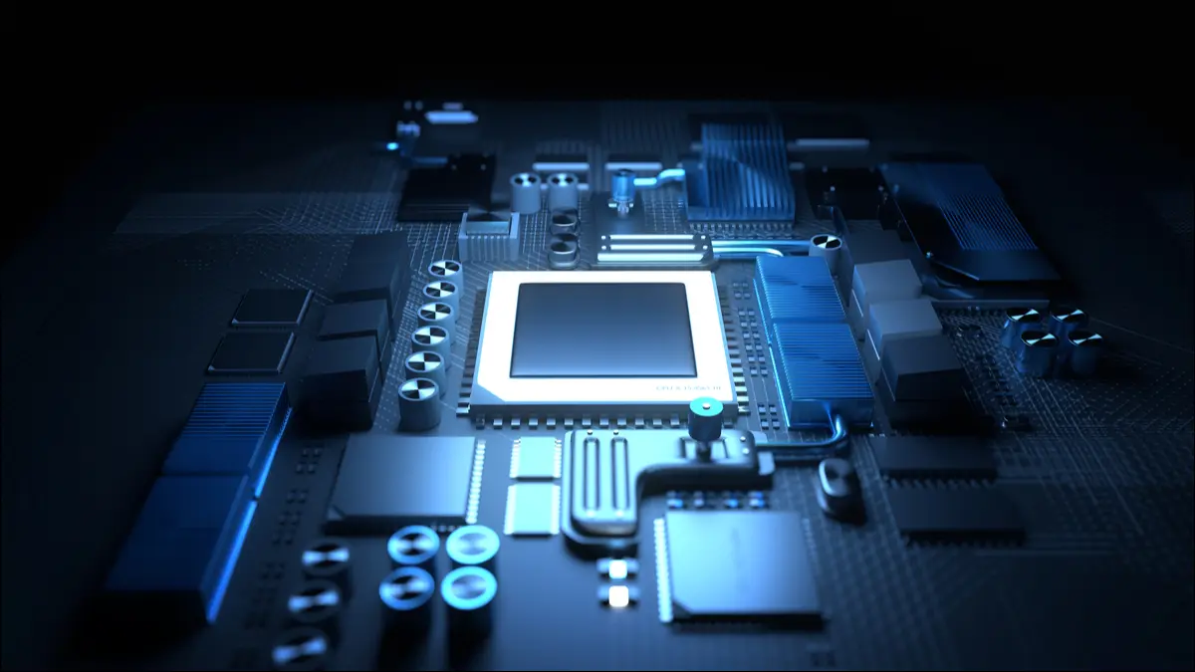
What determines the processor speed?
The speed of a smartphone determines whether the device can run demanding apps without slowing down. In addition, a smartphone with a lot of processing power boots apps faster.
The processor performs tasks and runs apps. The more powerful the processor, the more demanding apps you can use
Processors with low clock speeds and (sometimes) a smaller number of processor cores work more slowly than processors with high clock speeds and a large number of processor cores.
as that's what you're paying for, in the end. Actions performed on a cheaper smartphone will be processed more slowly than on a more expensive model.

Slide 4

Clock speed
The clock speed determines how many instructions the processor can execute per second.
A processor with a 1-Gigahertz (GHz) clock speed can process 1 billion instructions per second.
The general rule is that higher clock speeds make for faster phones. user can often see this with more expensive smartphones. Their processor cores have higher clock speeds than those of more affordable devices.
The number of processor cores also influences the speed of the smartphone.

Slide 5

NANOMETER TECHNOLOGY
nm stands for nanometer, a unit of measure for length. 1nm is equal to 0.000000001 meters—which is absolutely minute.
In a CPU, nm is used to measure the size of the transistors that make up a processor.
There are billions of transistors in a CPU that perform calculations through electrical signals by switching on and off.
Lower nm is better for your machine due to More Power Efficient, Less Cooling Required, Transistors Are Faster

Slide 6
WHY LOW NANOMETER TECHNOLOGY IS USED
More Power Efficient: a lower nm transistor means there is less power required for it to work. When you look at all the transistors in a CPU, lower power consumption makes a processor more power-efficient compared to a higher nm processor.
Less Cooling Required: when the transistors in your CPU consume less power, less heat is generated overall.
Transistors Are Faster: When the transistor size is smaller, there is less distance between them. Less distance means the electric signal will travel faster, making the overall performance of the CPU faster.

Slide 7
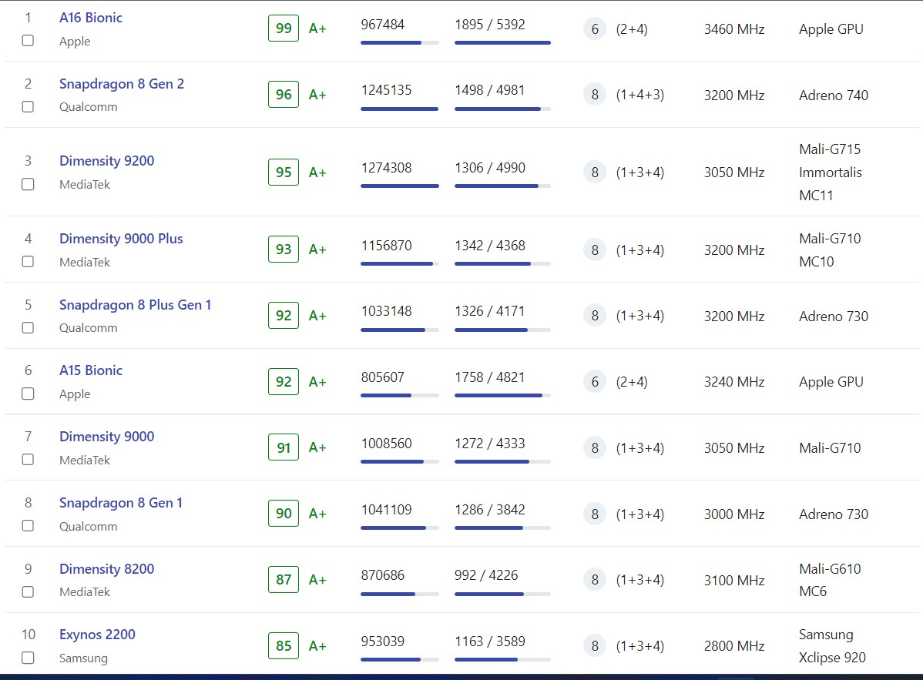
Smartphone Processors Ranking

Slide 8
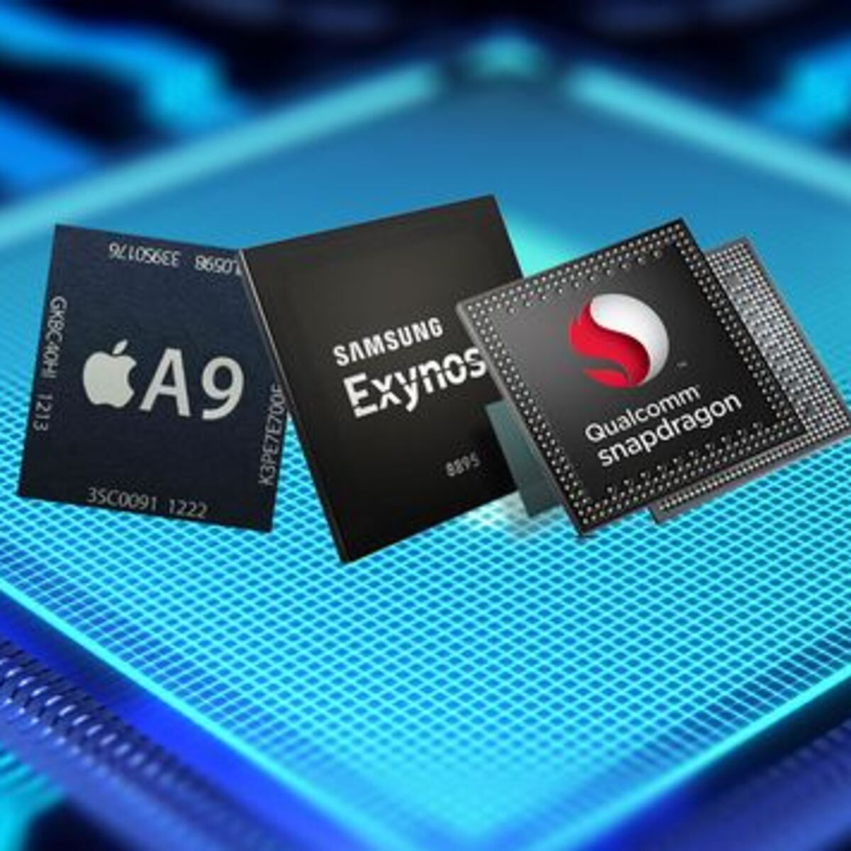
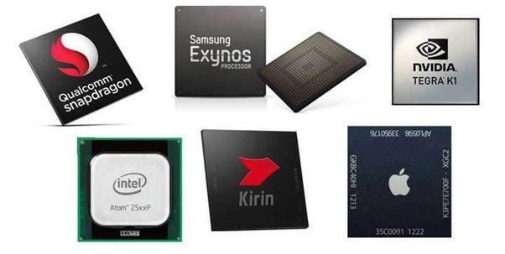
VARIOUS PROCESSORS IN MARKET
Apple bionic chips
Qualcomm snapdragon processors
Mediatek
Exynos
Kirin
Intelrom
Arm cortex

Slide 9

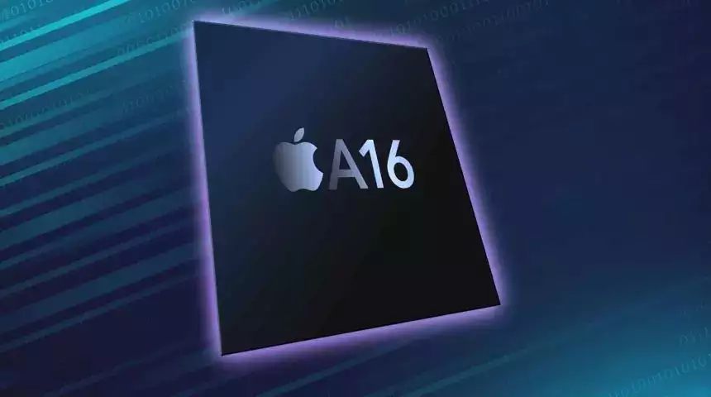
Apple bionic chips
The Apple A16 Bionic features an Apple-designed 64-bit six-core CPU implementing ARMv8.6-A. with two "Everest" high-performance cores running at 3.46 GHz
The A16 contains 16 billion transistors, a 6.7 % increase from the A15's transistor count of 15 billion.
this used in the iPhone 14 Pro and 14 Pro Max models only.

Slide 10
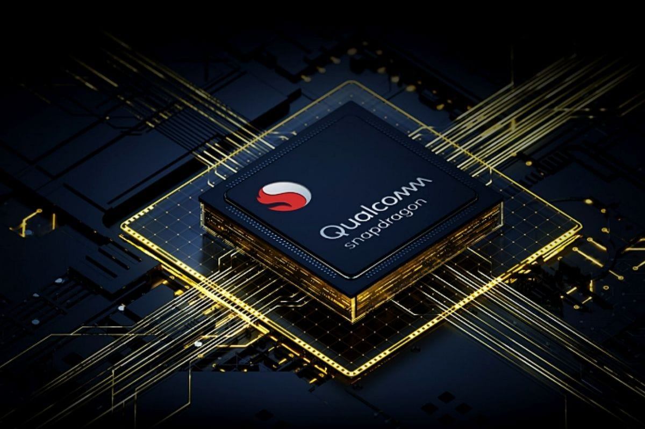
Qualcomm snapdragon processors
Qualcomm Snapdragon 8 Gen 2 – an 8-core chipset that was announced on November 15, 2022, and is manufactured using a 4-nanometer process technology
The Snapdragon 8 Gen 2 Mobile Platform is latest premium-tier powerhouse.
This is the company’s front runner and that which will power most of the flagships of 2023.
Some of the smartphones which use this processor are Vivo X90 Pro Plus, OnePlus 11 and Motorola Moto X40 etc

Slide 11

Mediatek Dimensity
The top mobile chip in MediaTek's stable is described as a "milestone of innovation," and that "everything inside its super powerful—yet super power efficient—4nm package screams flagship chip."
The Dimensity 9200 delivers a sizable 35 percent performance advantage over other Android flagships, and is reportedly 37 percent more power efficient too.
Some of the smartphones which use this processor are Vivo X90 Pro 5G, OnePlus Nord 5 and Vivo S17 Pro etc

Slide 12
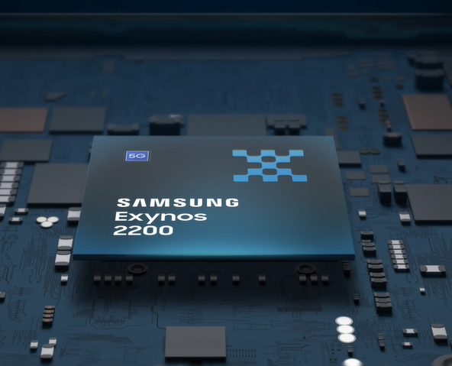
EXYNOS
The Samsung Exynos 2200 is a high end SoC with 8 cores in three clusters.
Samsung Exynos 2200 – an 8-core chipset that was announced on January 18, 2022, and is manufactured using a 4-nanometer process technology.
Some of the smartphones which use this processor are Samsung Galaxy S22 Ultra, Samsung Galaxy S22+ and Samsung Galaxy S22

Slide 13
REFERENCES
Purab Surana,Nishil Madhani, T Gopalakrishnan, “A Comparative Study on the Recent Smart Mobile Phone Processors”, 2020 7th International Conference
Dr. G. Shankar Lingam, “Progression of Hardware Platform of Mobile Phone Processors”, 2019
Prabhu; M. Potkonjak; J.M. Rabaey, “Processors for Future generation”, 2021
Hamid Eslampour, Mukul Joshi, “cost benefits in next generation Smartphone processors”, 2019

Slide 14
CONCLUSION
Processors have a major role to play in any device with its various components for processing and executing instructions.
The latest processors are coming up with a greater efficiency
The technology advancement expects to build up the more power proficient versatile processor designs for portable devices.

Slide 15


